Slide 1
Against Gun Control
Ryan Coslove rmc326

Slide 2
Introduction
In order to remain unbiased and allow the data to be objective, it is important to choose a reliable source.
One reliable source I found to be is the United Nations.
A new global survey — conducted by international research agency Glocalities with results released Monday in cooperation with Global Citizen — indicates that the UN is more trusted than any other international or governmental organization.

Slide 3
United Nations Office on Drugs and Crime
The division of the UN in reference is the Untied Nations Office on Drugs and Crime.
This is a report from 2014 created by the UN, which is titled “Global Study on Homicide”:
https://www.unodc.org/documents/gsh/pdfs/2014_GLOBAL_HOMICIDE_BOOK_web.pdf
Often guns are associated with homicide and crime in general. This report contains global data on their associations.

Slide 4
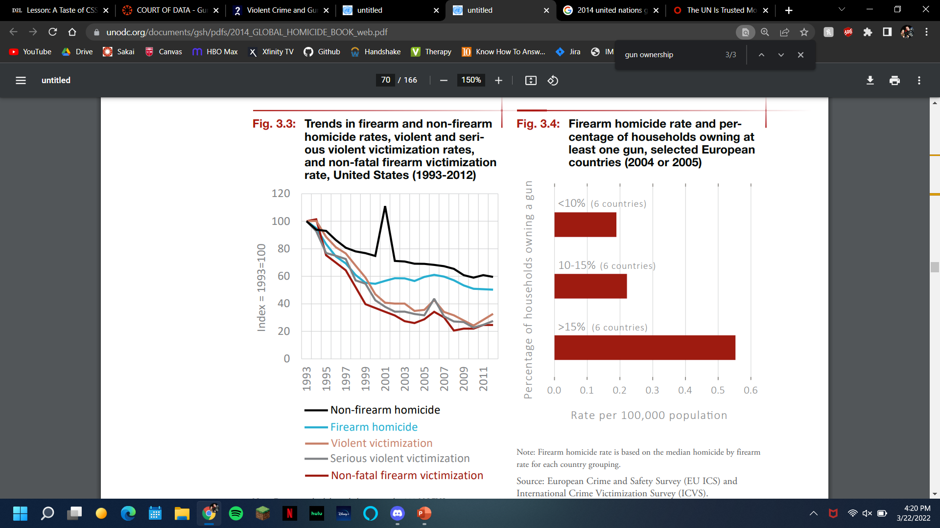
Firearms vs Homicide Rates and More
Using data collected over 19+ years, we can see in Figure 3.3 the firearm trends of homicide and victimization in the United States.
We know the United States one of the leading countries, if not the leading country, in firearm possession.
The graph (on page 68 of the report) suggests that firearms are not the leading cause of homicide.

Slide 5
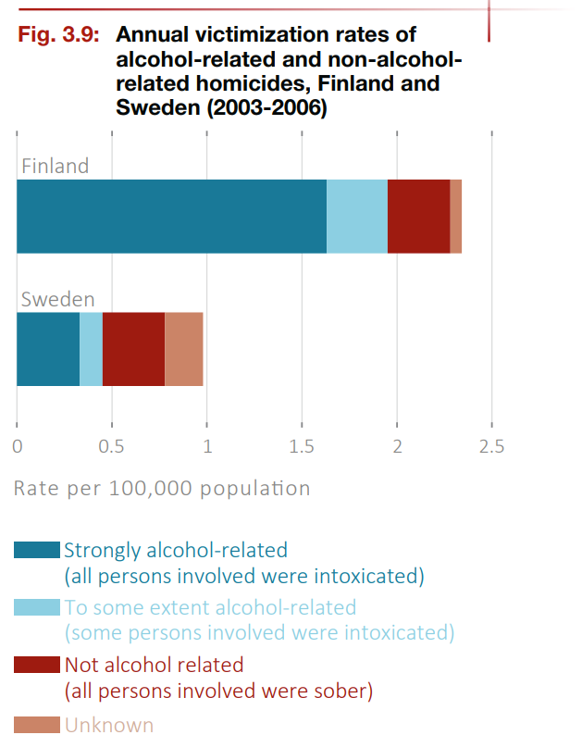
Annual Victimization Rates of Alcohol-related and Non-Alcohol Related Homicides
In Figure 3.9 (on Page 72), we see the Annual Victimization Rates of Alcohol-related and Non-Alcohol Related Homicides, Finland and Sweden (2003-2006).
Finland is considered a country with heavy gun ownership, and the figure suggests a majority of homicides occur when the offender is intoxicated.

Slide 6
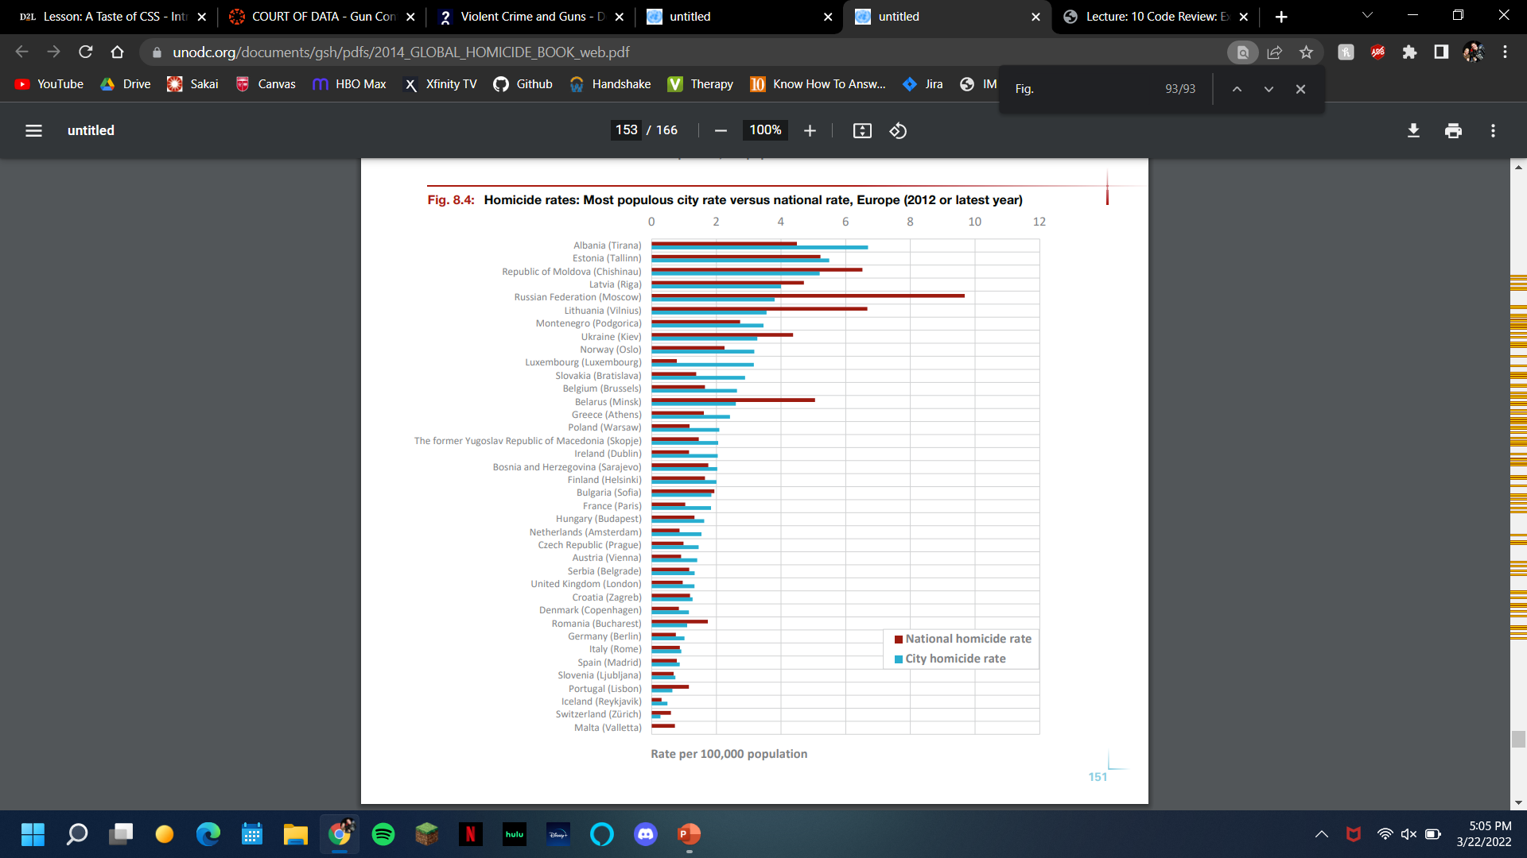
Homicide Rates in Europe
Norway, Finland, Germany, France and Denmark, all countries with heavy gun ownership, have a history of low murder rates. Using Figure 8.4, Germany's murder rate of 0.8 killings per 100,000 inhabitants was identical to Luxembourg, where the law prohibits civilian ownership of handguns and gun ownership is rare.

Slide 7
Washington Post
An article from the Washington Post, considered a generally credible resource, details gun control laws in Chicago.
The article is here:
https://www.washingtonpost.com/news/fact-checker/wp/2017/10/17/does-a-city-with-the-toughest-gun-laws-end-up-with-worst-gun-violence/

Slide 8
Washington Post’s Article
Within the U.S. picture isn't as uniform, because in addition to federal regulation, states across the U.S. have their own varying laws on firearms.
Opponents of gun control often point to the city of Chicago, which had 781 homicides and 3,000 shooting incidents in 2016, despite Illinois' relatively tough gun laws, as proof that gun control doesn't work.

Slide 9
Continued
The stats don’t tell us much without reference points from other cities.
Data on violent crime from 63 U.S. cities, compiled by the Major Cities Chiefs Association, show that in 2016 Chicago had the highest number of homicides and non-fatal shooting incidents.

Slide 10
Conclusions
Given our look at the report from the United Nations and the Washington Post article, we can deduce a few things about firearms and gun control.
From the UN report we learned that homicides most commonly occurred without a firearm.
We learned that most gun victimizations occurred when the offender was intoxicated with alcohol or drugs.
We learned that even in countries with a higher gun population, that legislation for more gun restrictions doesn’t affect the rate of homicide.
We also concluded that even in the cities with the toughest legislation, crimes that involved firearms were still evident with little to no improvement.
In general, it is important for people who possess firearms to be responsible and safe. However, tougher gun legislation does not prove to be successful in reducing the number of criminals in society.

